Slide 1
Natural Language Processing (NLP)
Lecture 10: Word Associations
Dr. Muhammad Taimoor Khan

Slide 2
Syntagmatic Word Association
Syntagmatic: A & B have syntagmatic relation if they can be combined with each other (i.e., A & B are related contextually)
–E.g., “cat” and “sit”; “car” and “drive”
These two basic and complementary relations can be generalized to describe relations of any items in a language

Slide 3
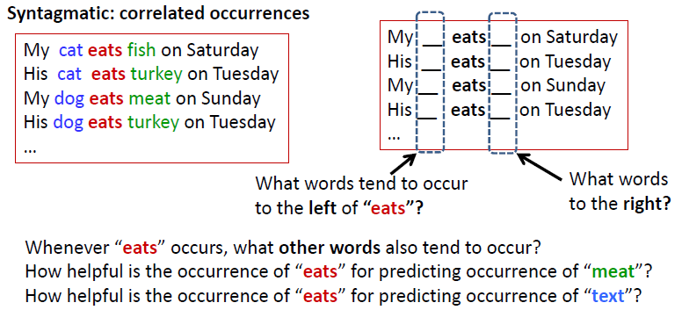
Mining word associations: Intuitions

Slide 4
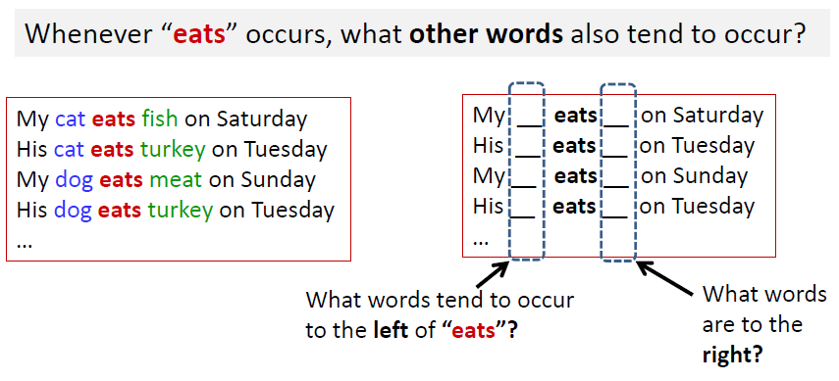
Syntagmatic Relations: Correlated Occurrences

Slide 5
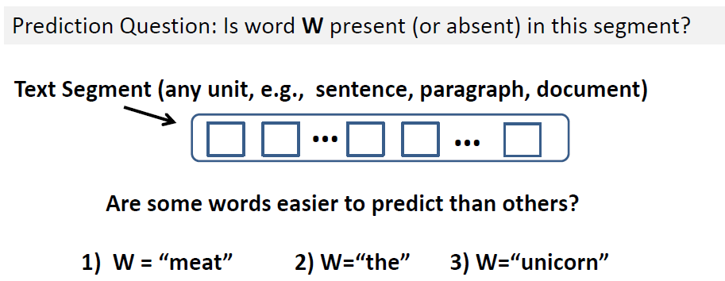
Word Prediction: Intuition

Slide 6
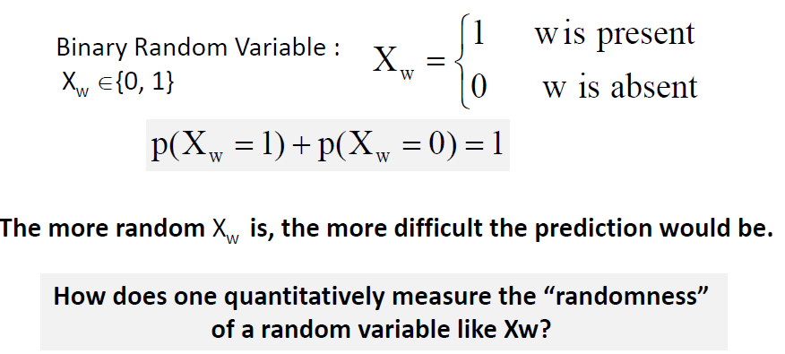
Word Prediction: Formal Definition

Slide 7
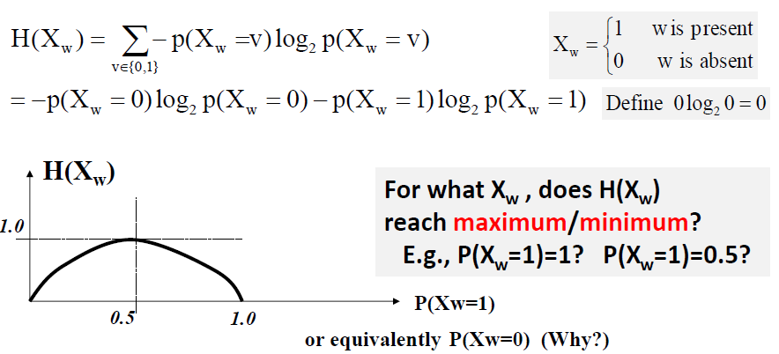
Entropy H(X) Measures Randomness of X

Slide 8
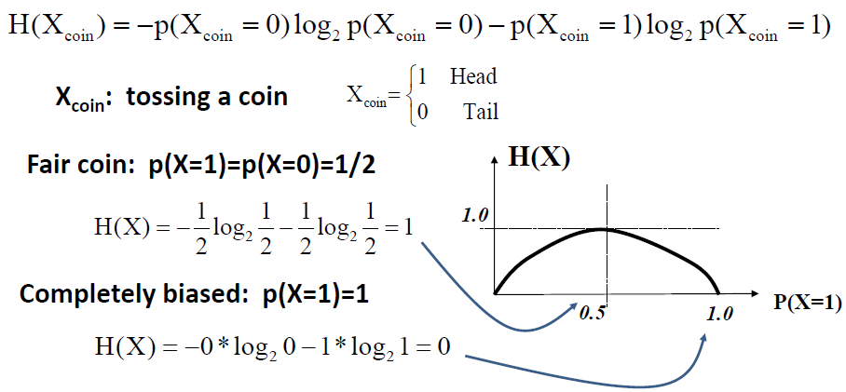
Entropy H(X): Coin Tossing

Slide 9
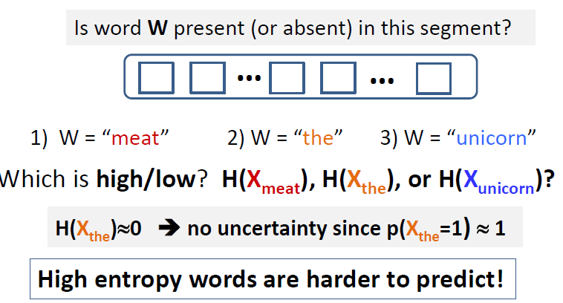
Entropy for Word Prediction

Slide 10
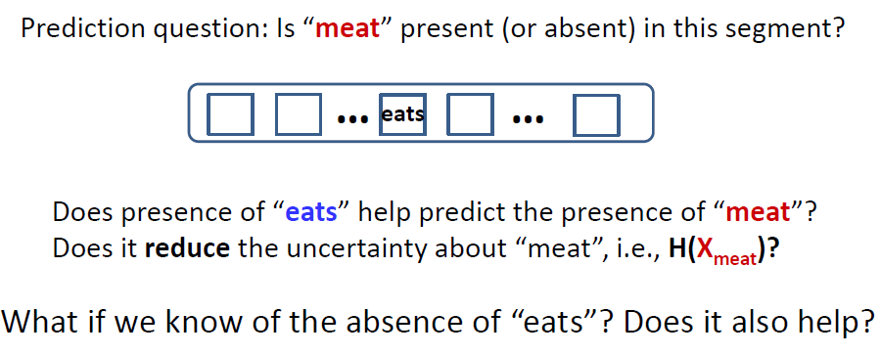
What if we know more about a text segment

Slide 11
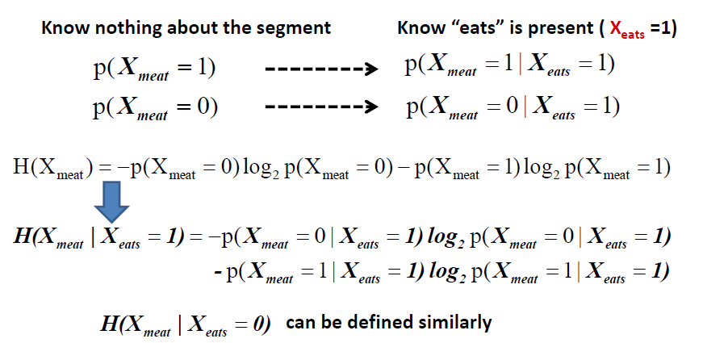
Conditional Entropy

Slide 12
In general, for any discrete random variables X and Y, we can have
What’s the minimum possible value for H(X|Y)?

Slide 13
Conditional Entropy to Capture Syntagmatic Relation
Which is smaller? or ?
For which word w, does reach its minimum (i.e., 0)?
For which word w, does reach its maximum value?

Slide 14
For each word w1
For every other word w2, compute conditional entropy
Sort all the candidate words in ascending order of
Take the top ranked candidate words as words that have potential syntagmatic relationship with w1.
Need to use a threshold for each w1
However, while and are comparable, and aren’t!
We may need to mine the K strongest syntagmatic relations from a collection.

Slide 15
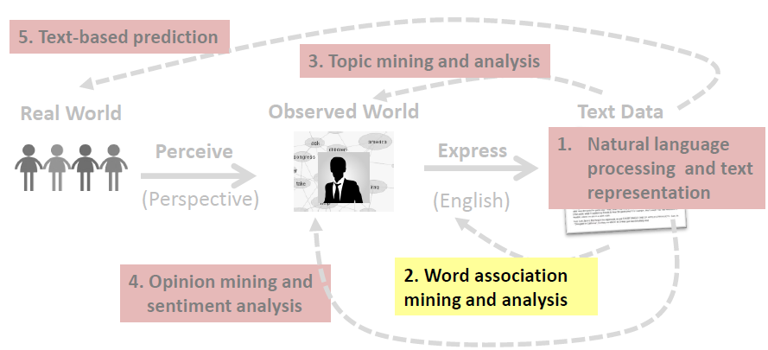
Syntagmatic relation discovery: Mutual Information

Slide 16
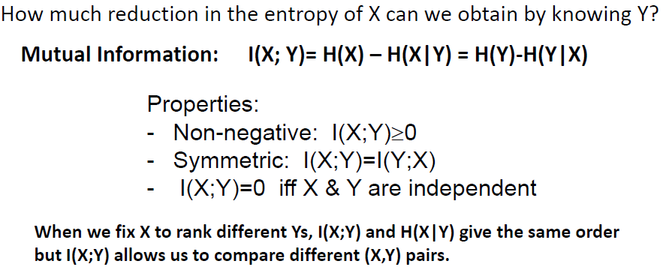
Mutual Information I(X;Y): Measuring Entropy Reduction

Slide 18
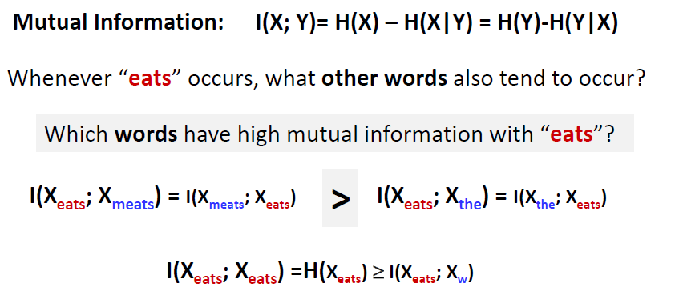
Mutual Information I(X;Y) for Syntagmatic Relation Mining

Slide 19
Summary of syntagmatic relation discovery
Syntagmatic relation can be discovered by measuring correlations between occurrences of two words.
Three concepts from Information Theory:
–Entropy H(X): measures the uncertainty of a random variable X
–Conditional entropy H(X|Y): entropy of X given we know Y
–Mutual information I(X;Y): entropy reduction of X (or Y) due to knowing Y (or X)
Mutual information provides a principled way for discovering syntagmatic relations.

